Slide 1
Lab-2
Course code: CSE-407
Course Title: Artificial Intelligence & Neural Networks

Slide 2

Confusion Matrix
Confusion Matrix is NOT Confusing!

Slide 3
Confusion Matrix
A confusion matrix is a table that is often used to describe the performance of a classification model (or “classifier”) on a set of test data for which the true values are known.
It allows the visualization of the performance of an algorithm.
We compare each class with every other class and see how many samples are misclassified.
We actually come across several key metrics that are very important in the field of machine learning.

Slide 4
Confusion Matrix Classification
Let's consider a binary classification case where the output is either 0 or 1:
True positives: These are the samples for which we predicted 1 as the output and the ground truth is 1 too.
True negatives: These are the samples for which we predicted 0 as the output and the ground truth is 0 too.
False positives: These are the samples for which we predicted 1 as the output but the ground truth is 0. This is also known as a Type I error.
False negatives: These are the samples for which we predicted 0 as the output but the ground truth is 1. This is also known as a Type II error.

Slide 5
Confusion Matrix Classification
True Positive(TP):
You projected positive and its turn out to be true. For example, you had predicted that France would win the world cup, and it won.
True Negative(TN):
When you predicted negative, and it's true. You had predicted that England would not win and it lost.
False Positive(FP):
Your prediction is positive, and it is false.
You had predicted that England would win, but it lost.
False Negative(FN):
Your prediction is negative, and result it is also false.
You had predicted that France would not win, but it won.

Slide 6
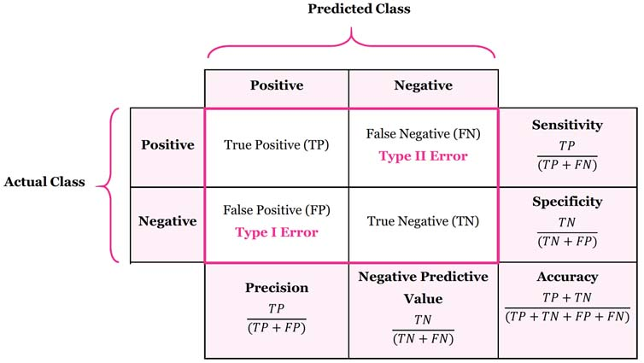
Confusion Matrix Classification

Slide 7
Support Vector Machines
A Support Vector Machine (SVM) is a discriminative classifier formally defined by a separating hyperplane.
A Support Vector Machine (SVM) is a classifier that is defined using a separating hyperplane between the classes.
In other words, given labeled training data (supervised learning), the algorithm outputs an optimal hyperplane which categorizes new examples.
In two dimensional space this hyperplane is a line dividing a plane in two parts where in each class lay in either side.
SVM finds the optimal hyperplane that separates the training data into two classes.

Slide 8

Objective of SVM
The objective of the support vector machine algorithm is to find a hyperplane in an N-dimensional space(N — the number of features) that distinctly classifies the data points.

Slide 9
Objective of SVM
To separate the two classes of data points, there are many possible hyperplanes that could be chosen.
Our objective is to find a plane that has the maximum margin, i.e. the maximum distance between data points of both classes.
Maximizing the margin distance provides some reinforcement so that future data points can be classified with more confidence.

Slide 10
Hyperplanes at SVM
Hyperplanes are decision boundaries that help classify the data points. Data points falling on either side of the hyperplane can be attributed to different classes.
Also, the dimension of the hyperplane depends upon the number of features. If the number of input features is 2, then the hyperplane is just a line.
If the number of input features is 3, then the hyperplane becomes a two-dimensional plane. It becomes difficult to imagine when the number of features exceeds 3.

Slide 11
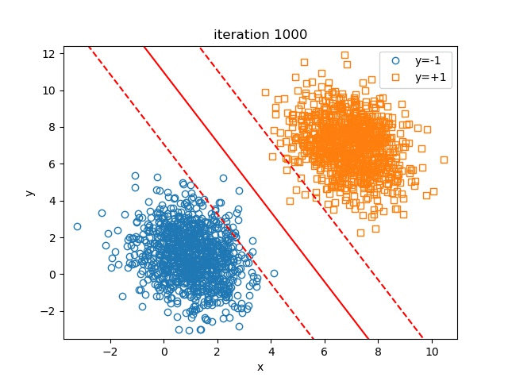
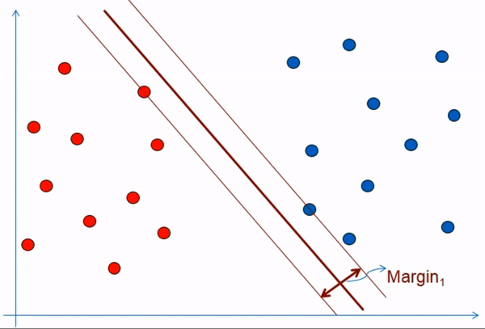
Hyperplanes at SVM
Support vectors are data points that are closer to the hyperplane and influence the position and orientation of the hyperplane. Using these support vectors, we maximize the margin of the classifier. Deleting the support vectors will change the position of the hyperplane.

Slide 12
SVM Algorithm
Types of SVM
SVM can be of two types:
Linear SVM: Linear SVM is used for linearly separable data, which means if a dataset can be classified into two classes by using a single straight line, then such data is termed as linearly separable data, and classifier is used called as Linear SVM classifier.
Non-linear SVM: Non-Linear SVM is used for non-linearly separated data, which means if a dataset cannot be classified by using a straight line, then such data is termed as non-linear data and classifier used is called as Non-linear SVM classifier.

Slide 13
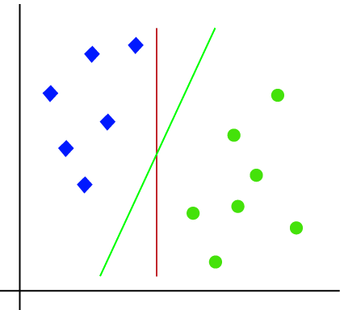
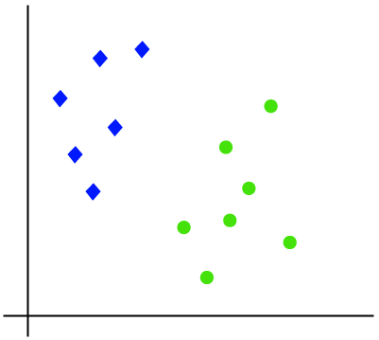
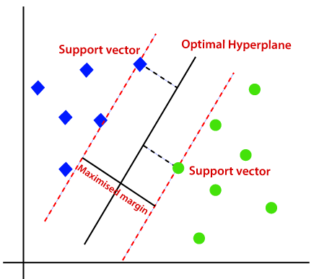
SVM Algorithm (Linear SVM)
The working of the SVM algorithm can be understood by using an example.
Suppose we have a dataset that has two tags (green and blue), and the dataset has two features x1 and x2.
We want a classifier that can classify the pair(x1, x2) of coordinates in either green or blue. Consider the below image:
So as it is 2-d space so by just using a straight line, we can easily separate these two classes. But there can be multiple lines that can separate these classes. Consider the below image:
Hence, the SVM algorithm helps to find the best line or decision boundary; this best boundary or region is called as a hyperplane.
SVM algorithm finds the closest point of the lines from both the classes. These points are called support vectors.
The distance between the vectors and the hyperplane is called as margin.
And the goal of SVM is to maximize this margin.
The hyperplane with maximum margin is called the optimal hyperplane.

Slide 14
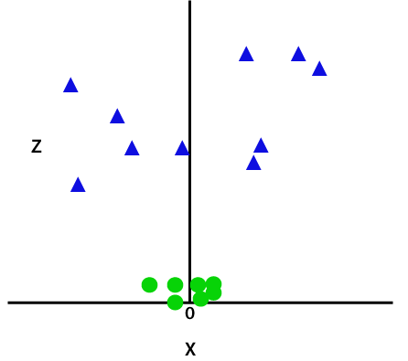
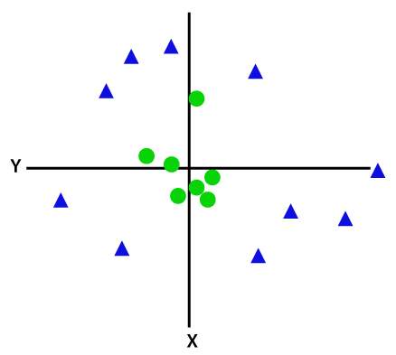
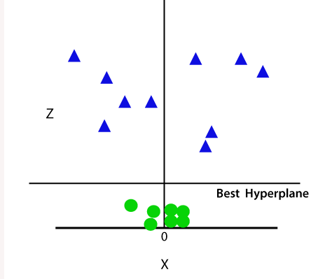
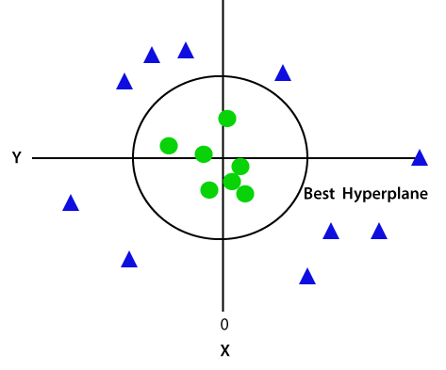
SVM Algorithm (Non-Linear SVM)
If data is linearly arranged, then we can separate it by using a straight line, but for non-linear data, we cannot draw a single straight line. Consider the below image:
By adding the third dimension, the sample space will become as below image:
So now, SVM will divide the datasets into classes in the following way. Consider the below image:
So to separate these data points, we need to add one more dimension. For linear data, we have used two dimensions x and y, so for non-linear data, we will add a third dimension z. It can be calculated as:
Since we are in 3-d Space, hence it is looking like a plane parallel to the x-axis. If we convert it in 2d space with z=1, then it will become as:
z=x² +y²

Slide 15
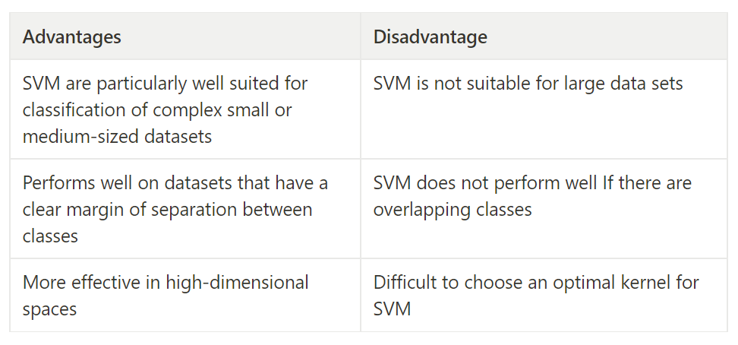

Slide 16
Thanks'

